Slide 1
Psychosis classification using SVM with diffusion MRI and cognitive test scores
Yu Veronica Sui

Slide 2
datasets
41 patients with psychosis
Aged 18-30
Diagnosis: schizophrenia, schizoaffective, bipolar with psychotic features
35 age-matched healthy controls
Training (54)
25 healthy controls
29 patients with psychosis
Testing (22)
10 healthy controls
12 patients with psychosis

Slide 3
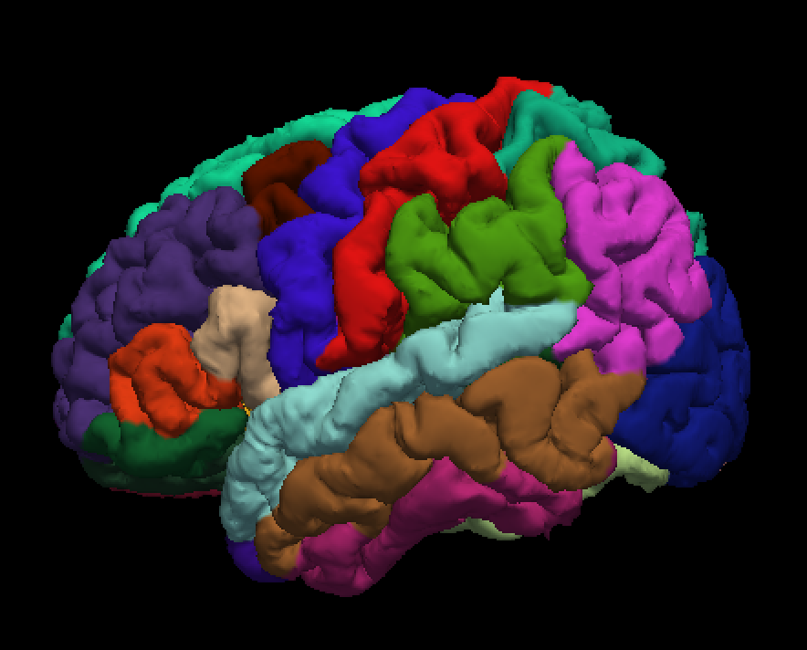
datasets
Diffusion MRI data
Mean diffusion kurtosis, whole brain coverage
Treating every brain region as a variable
Cognitive test scores
24 tests in total
IQ
Recall/recognition
Symbol coding
Processing speed
…
In the left and right hemispheres:
- 34 grey matter regions each
- 34 white matter regions each
- 7 subcortical structures each
- 4 cerebellum and diencephalon
regions each
Corpus callosum: 5 sub-regions

Slide 4
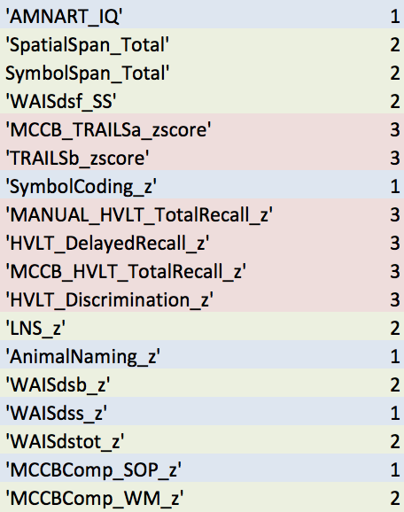
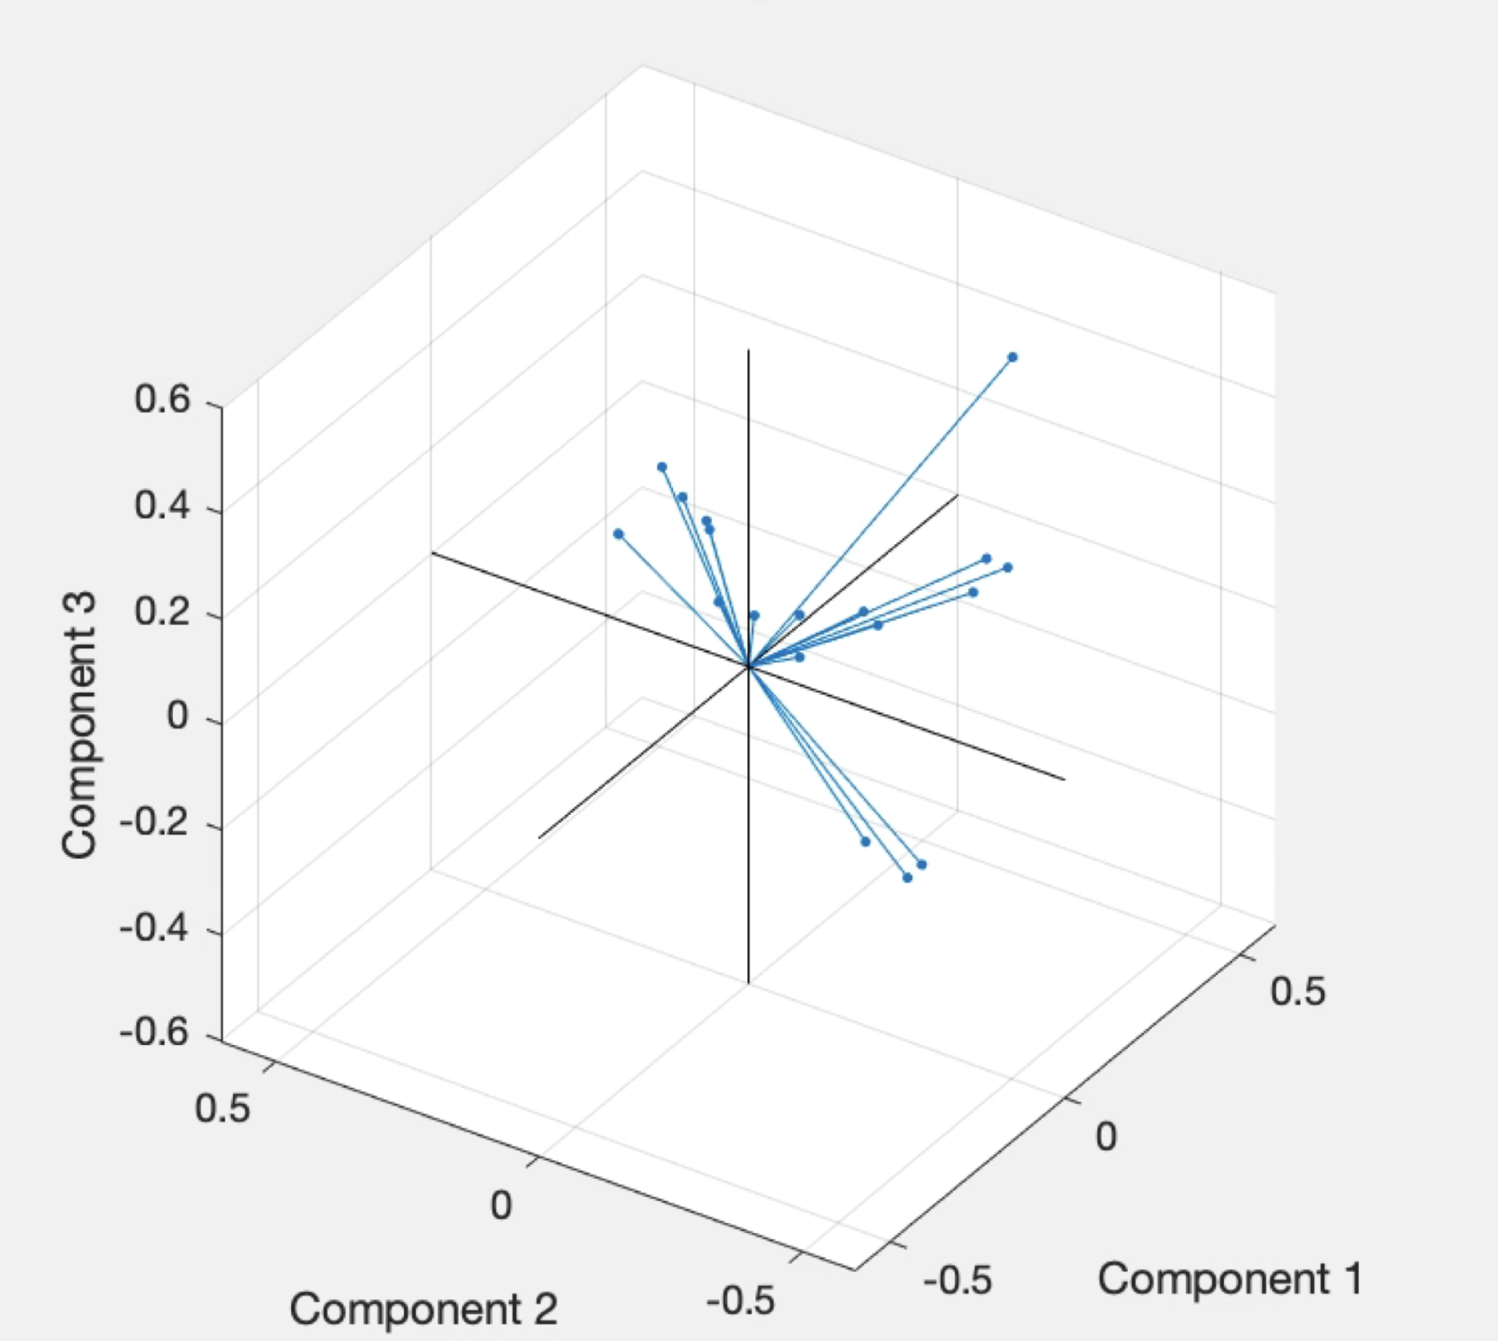
datasets
Diffusion MRI data
Mean diffusion kurtosis, whole brain coverage
Average corresponding regions in the left and right hemisphere?
Cognitive test data
24 tests in total
3 PCs: processing speed, working memory, learning
Left hemisphere
Right hemisphere
Mean MK

Slide 5
datasets
Diffusion MRI data
Mean diffusion kurtosis, whole brain coverage
Average corresponding regions in the left and right hemisphere?
Probably not
Cognitive test data
24 tests in total
3 PCs: processing speed, working memory, learning

Slide 6
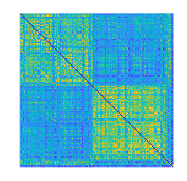
Inter-region correlation (Pearson’s r)
lh gm
rh gm
lh wm
rh wm
nuclei
158 regions
lh gm rh gm lh wm rh wm
158 regions
Regions alphabetically ordered

Slide 7
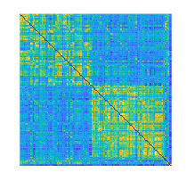
Inter-region correlation (Pearson’s r)
Inter-region correlation (Pearson’s r)
lh gm
rh gm
lh wm
rh wm
nuclei
158 regions
lh gm rh gm lh wm rh wm
158 regions
158 regions
Regions alphabetically ordered
Regions ordered by proximity

Slide 8
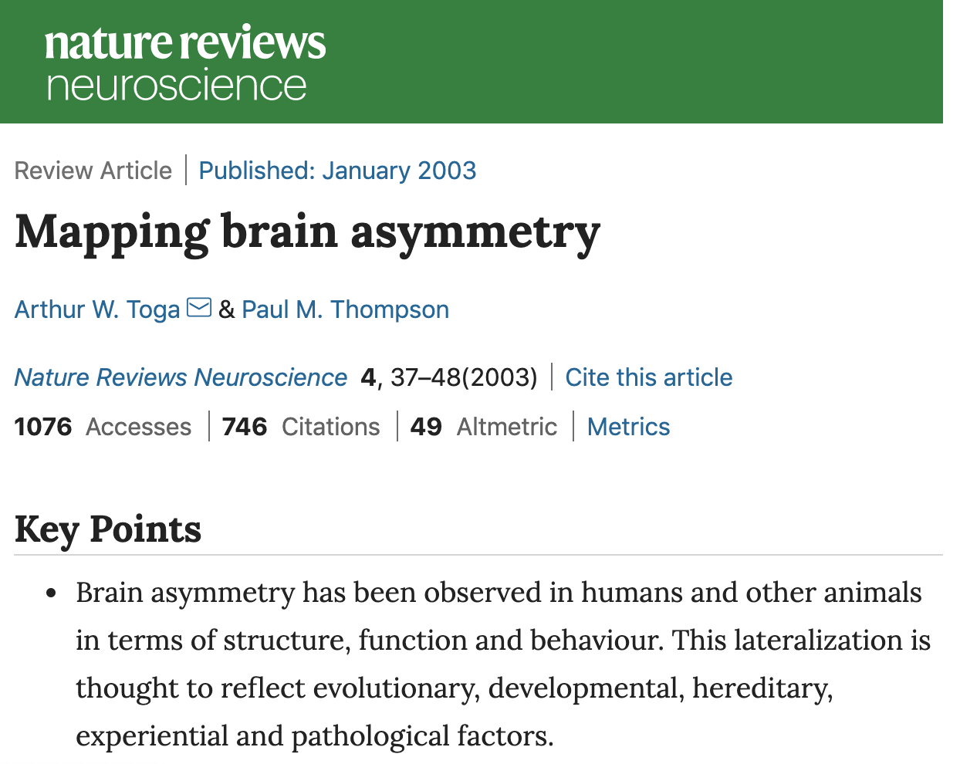
datasets
Diffusion MRI data
Mean diffusion kurtosis, whole brain coverage
Average corresponding regions in the left and right hemisphere?
Probably not
Feature selection

Slide 9
Support vector machine
- Train a binary classifier that distinguishes healthy controls from patients with psychosis

Slide 10
Support vector machine
Data-driven
Select features in the training set that are deemed “important” in a feature selection algorithm
Literature-driven
Select features that are found to be associated with schizophrenia spectrum disorder or psychosis in previous studies
- Train a binary classifier that distinguishes healthy controls from patients with psychosis

Slide 11
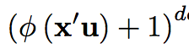
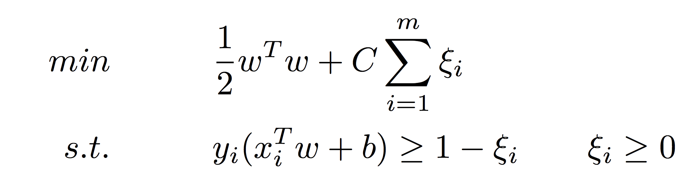
Support vector machine
SVM
Polynomial kernel
Optimization
K-fold cross-validation
Hyperparameters tuned
Polynomial degree d
where 𝜙 = 1
Box constraint C (weight of misclassifications)
- Train a binary classifier that distinguishes healthy controls from patients with psychosis

Slide 12
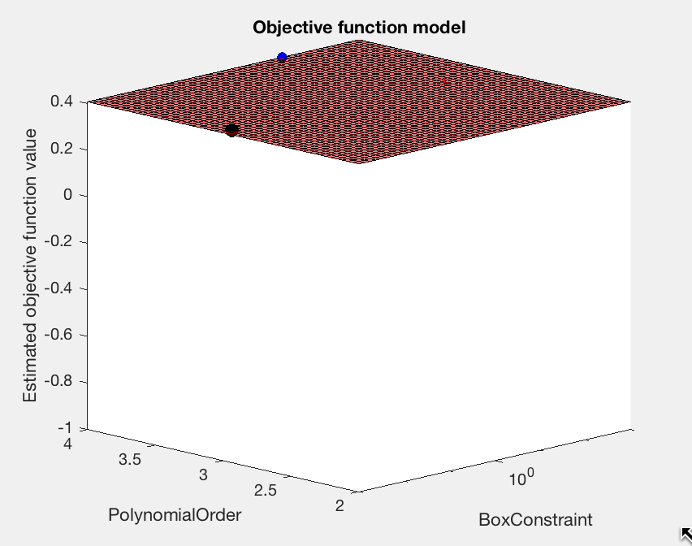
Support vector machine
SVM
Polynomial kernel
Optimization
K-fold cross-validation
Hyperparameters tuned
Polynomial degree d
where 𝜙 = 1
Box constraint C (weight of misclassifications)
- Train a model that distinguishes healthy controls from patients with psychosis

Slide 13
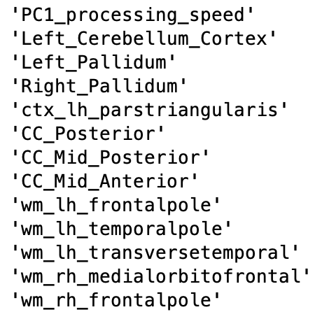
Automated Feature selection
Neighborhood component analysis (NCA) feature selection from Matlab
Learns the weights of features that maximize prediction accuracy of the classification
Manually-set threshold that gave out 13 most important features

Slide 14
Automated Feature selection
Neighborhood component analysis (NCA) feature selection from Matlab
Learns the weights of features that maximize prediction accuracy of the classification
Manually-set threshold that gave out 13 most important features
|=================================================================================================|
|Iter| Eval | Objective | Objective | BestSoFar | BestSoFar | BoxConstraint| PolynomialOrder|
| | result | | runtime | (observed) | (estim.) | | |
|=================================================================================================|
| 27 | Accept | 0.31481 | 0.05644 | 0.31481 | 0.31483 | 7.5321 | 2 |

Slide 15
Automated Feature selection
Model performance on test set

Slide 16
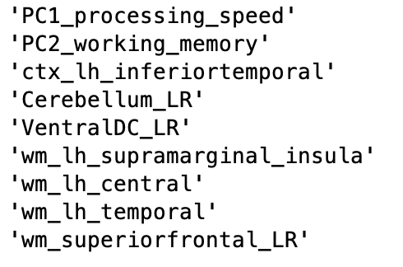
Literature-based Feature selection
Select features that are found to be associated with schizophrenia spectrum disorder or psychosis
PC1 processing speed and PC2 working memory
Brain regions
Bilateral …
Cerebellum, ventral diencephalon
Prefrontal white matter
Left hemisphere …
Inferior temporal cortex
WM tracts: inferior fronto-occipital fasciculus, inferior/superior longitudinal fasciculus
left and right cerebellum
left and right ventral diencephalon
wm_lh_supramarginal+insula
wm_lh_precentral+postcentral
wm_lh_transverse+superior+middle temporal
left and right wm_superiorfrontal
Carletti et al., 2012; Dietsche et al., 2017; Schultz et al., 2017

Slide 17
Literature-based Feature selection
Select features that are found to be associated with schizophrenia spectrum disorder or psychosis
PC1 processing speed and PC2 working memory
Brain regions
|=================================================================================================|
|Iter| Eval | Objective | Objective | BestSoFar | BestSoFar | BoxConstraint| PolynomialOrder|
| | result | | runtime | (observed) | (estim.) | | |
|=================================================================================================|
| 22 | Accept | 0.24074 | 0.062436 | 0.24074 | 0.24028 | 0.40716 | 2 |

Slide 18
Literature-based Feature selection
Model performance on test set

Slide 19
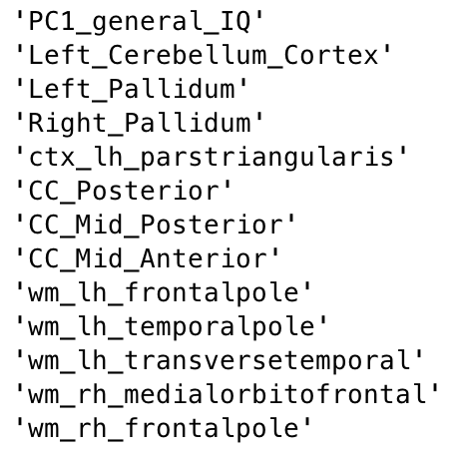
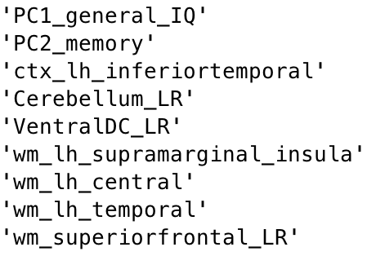
Compare feature sets

Slide 20
Random feature selection
Sanity check
feature_ID = randperm(166,13)

Slide 21
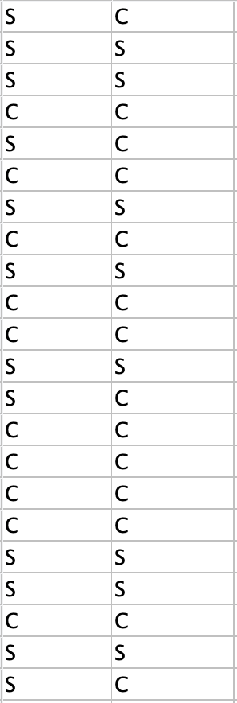
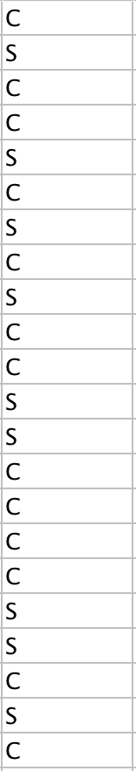
SVM prediction
C – control S – psychosis patient
- Hits and misses
Mislabel
True Predictions
Literature FS
Automated FS

Slide 22
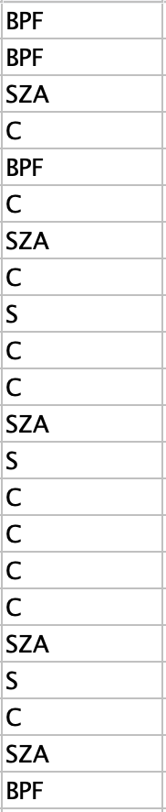
SVM prediction
C – control S – psychosis patient
SZ – schizophrenia
SZA – schizoaffective
BPF – bipolar with
psychotic features
- Hits and misses
Mislabel
True Predictions
Literature FS
Automated FS

Slide 23
SVM prediction
C – control S – psychosis patient
SZ – schizophrenia
SZA – schizoaffective
BPF – bipolar with
psychotic features
BPF mislabeled as control
Underrepresented
27 SZ+SZA
14 BPF
Higher within-group variance
BPF is less severe than SZ-spectrum disorder
- Hits and misses
Mislabel
True Predictions
Literature FS
Automated FS

Slide 24
Thank you!
Questions?

